Slide 1

Improving the Performance of Performance Management –
Why Changes Are Needed
Terry L. Poling
July 2016

Slide 2
“Performance reviews are a curse on corporate America.”
Samuel Culbert,
UCLA Researcher

Slide 3
Today’s Agenda
What’s Changing: Latest Trends
Our Assessment Experiences
Common Assessment Errors
What’s Needed: 3 Essential Elements
Improving Engagement & Feedback
Using the SARS Model

Slide 4







What’s Changing: Latest Trends

Slide 5
What’s Changing: Latest Trends
90% of companies surveyed by SHRM reported using annual reviews, but only 30% believed they did it well. (Fast Company, 2015).
Only 46% of millennials believe their managers delivered on their expectations for feedback. (Workforce 2020 Research).
According to 2015 Wakefield Research on 1,000 full-time millennial-age employees:
74% feel “in the dark” in terms of their performance.
62% report that they are frequently “blind-sided” by their managers.
59% believe their managers are unprepared to give feedback at the time of their reviews.
50% say annual reviews focus mostly on “gaps” and make them feel they can’t do anything right.
Only 32% of review conversations encourage or allow employees to share their
own thoughts on performance.
69% see their company’s performance appraisal system as flawed.

Slide 6
Assessment Experience
Recall a memorable time or situation in your life when you were assessed, judged, or evaluated.
It could have occurred when you were in school, at home, at work, on stage, in the gym, or elsewhere.
Identify the family member, teacher, coach, colleague, boss, or other person who was involved.
What happened? What message did you receive?
How did it effect or impact you?

Slide 7
Assessment Errors
Common Biases
“Halo” or “Horns” Effect
“Same As Me” Syndrome
Recency Effect
“Super Human” Strictness
Leniency
“Middle-of-the-Road” Effect
Third Party Influences

Slide 8
What’s Needed:
Three Most Critical Elements
  Active Two-Way Engagement
  Shared Expectations
  Frequent and Developmental Feedback

Slide 9
Frequent & Developmental Feedback
Two primary functions of feedback
  To reinforce behaviors
  To correct behaviors
Two ways to house-break a puppy
Most powerful and least utilized management tool

Slide 10
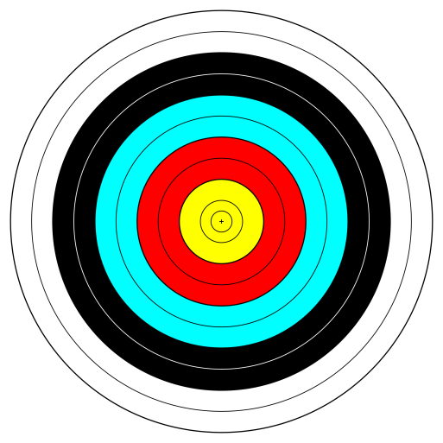
Missed High-Leverage Opportunities
Reinforcement Feedback
Corrective Feedback

Slide 11
Engagement & Feedback Guidelines
More Effective
Specific
Descriptive
Behavioral
Timely
Usable
Direct
Supportive
Future-Oriented
Two-Way
Less Effective
General
Evaluative
Personal
Delayed
Available
Indirect
Threatening
Past-Oriented
One-Way

Slide 12
SARS Model
Actions
Situation
Results

Slide 13
SARS Model
As a Planning Tool: Co-Creating Shared Expectations
Projects/Tasks
Opportunity/Problem
Objectives/Outcomes

Slide 14
SARS Model
As an Assessment Tool: Engaging for Frequent
& Developmental Feedback
Behaviors/Decisions
Rationale/Motivation
Impact/Consequences

Slide 15
SARS Model
Actions
Situation
Results

Slide 16
Applying the SARS Model
Use the cards provided on your table.
Decide if you’ll use SARS to: 1) co-create shared expectations with someone, or 2) engage someone in a feedback conversation.
Make notes on Situation, Actions, Results.
Share your plan with a partner and seek feedback and suggestions.

Slide 17
Be Sure To Include In Your
Performance Management Process
  Active Two-Way Engagement
  Shared Expectations
  Frequent and Developmental Feedback
  Some form of the SARS Model

Slide 18
QUESTIONS?
COMMENTS?
View Presentation at http://www.thepolinggroup.com/blog-a-point-of-view/
View Forbes Article at https://www.facebook.com/The-Poling-Group-Inc-662840933785443/

